Slide 1
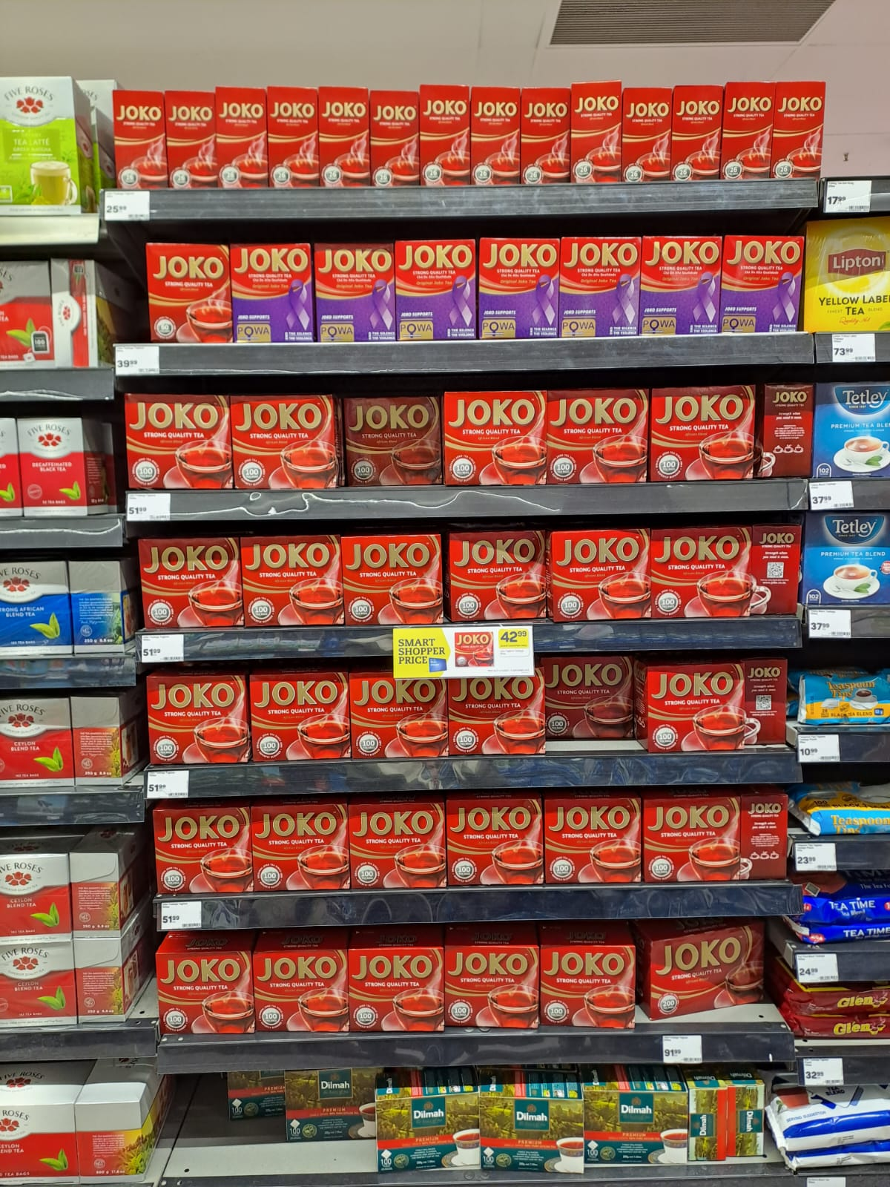
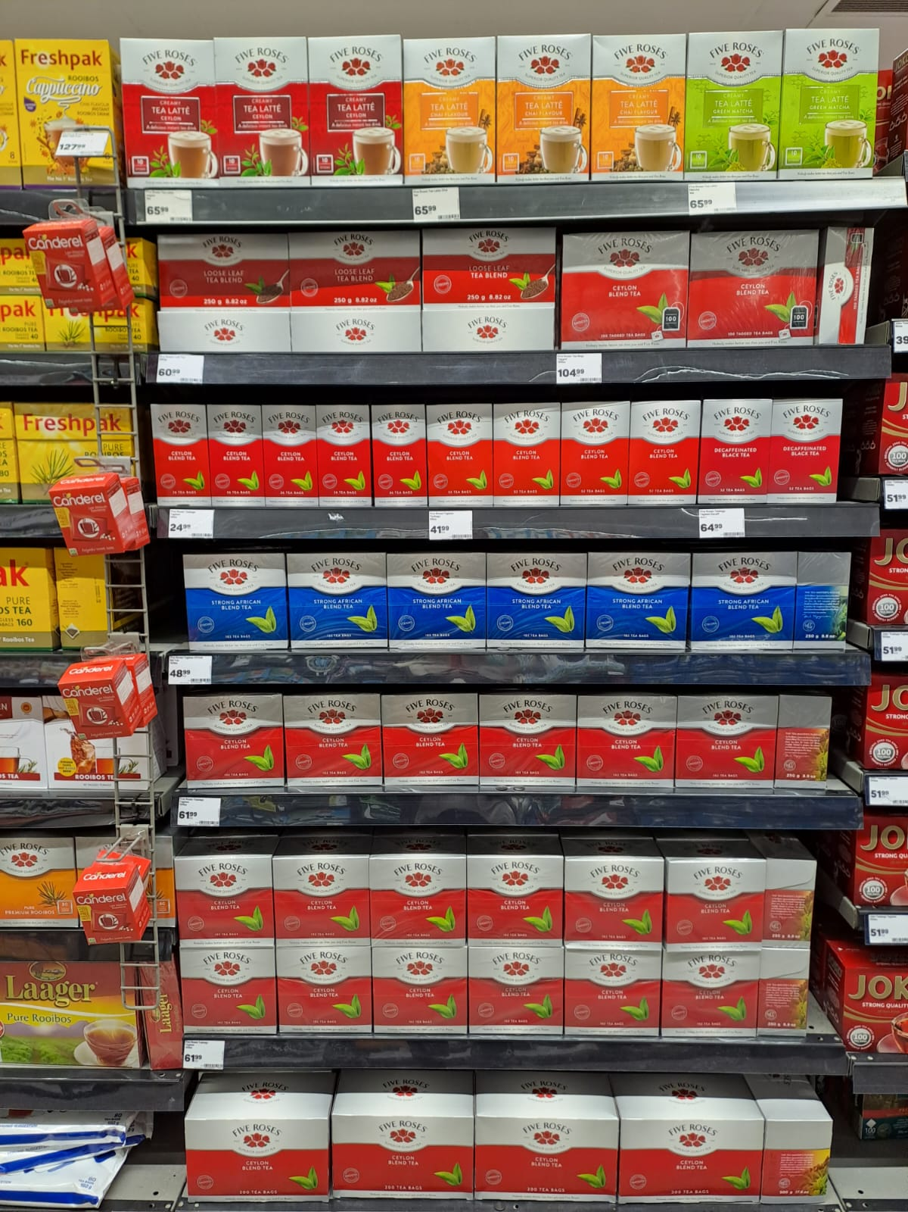
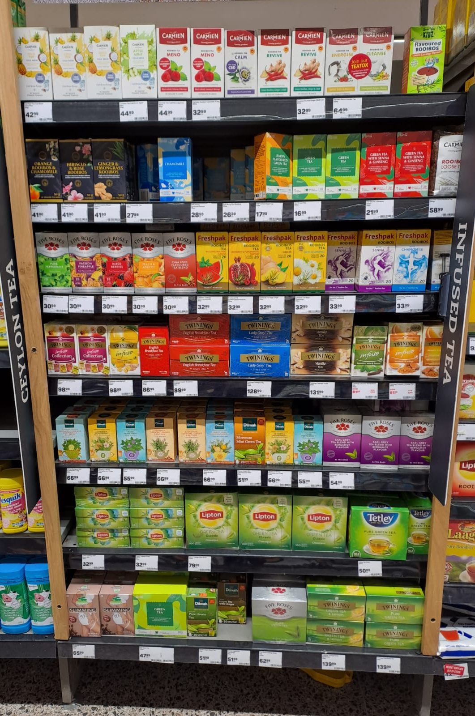
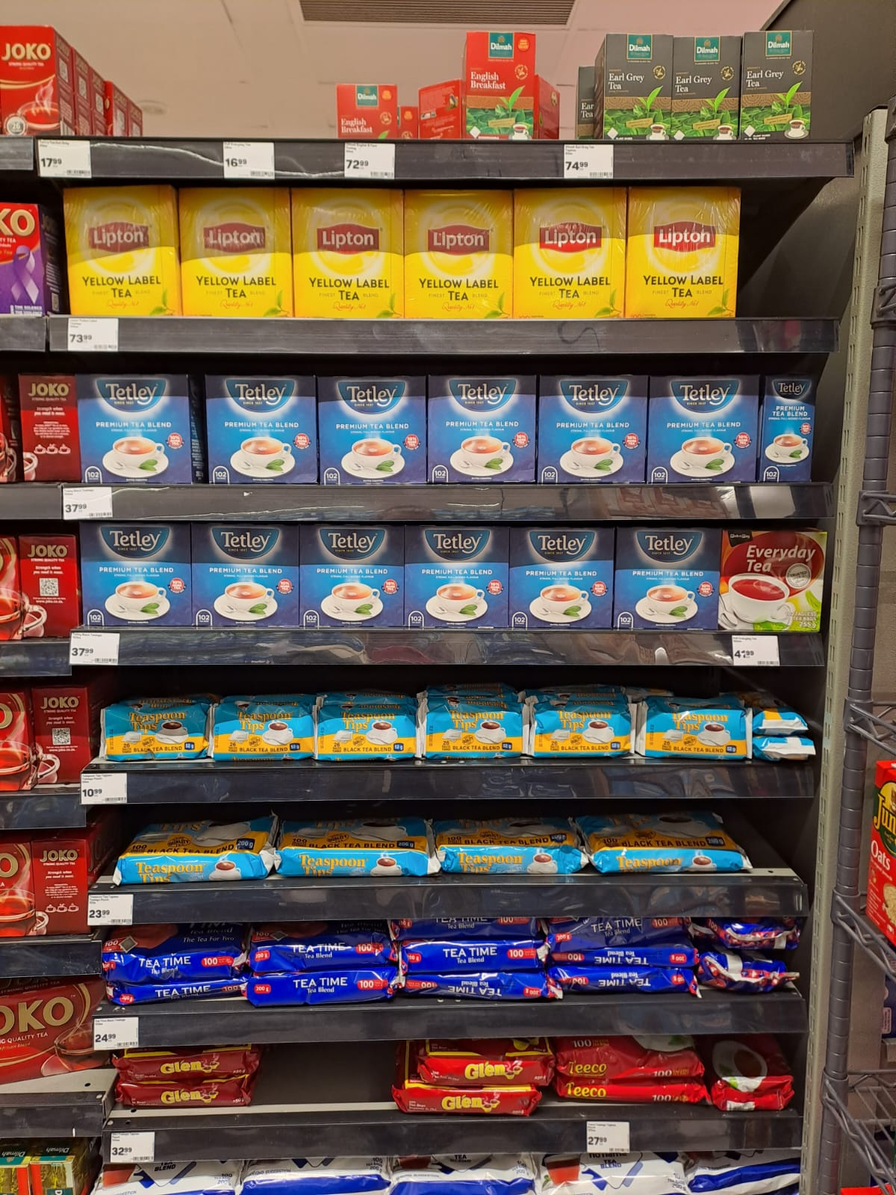
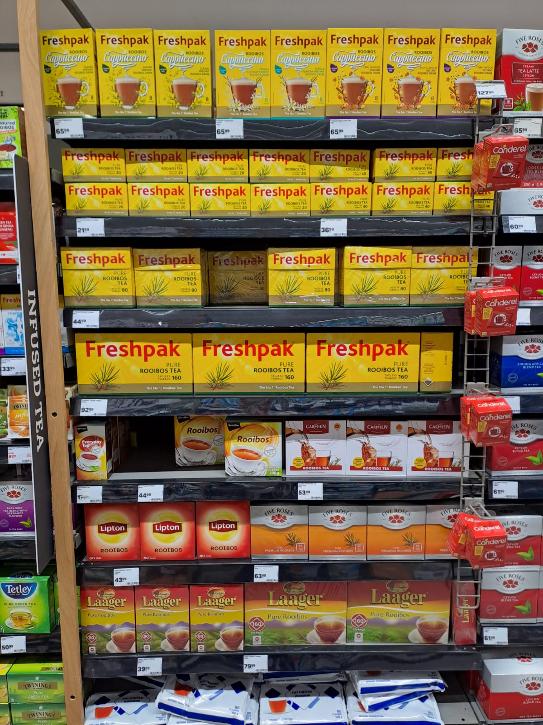
Pick n Pay
Gqeberha
Source: Rachel Putzier (2023)
Notes:
Present my preliminary findings for my thesis
Supervisor is Gillian

Slide 2
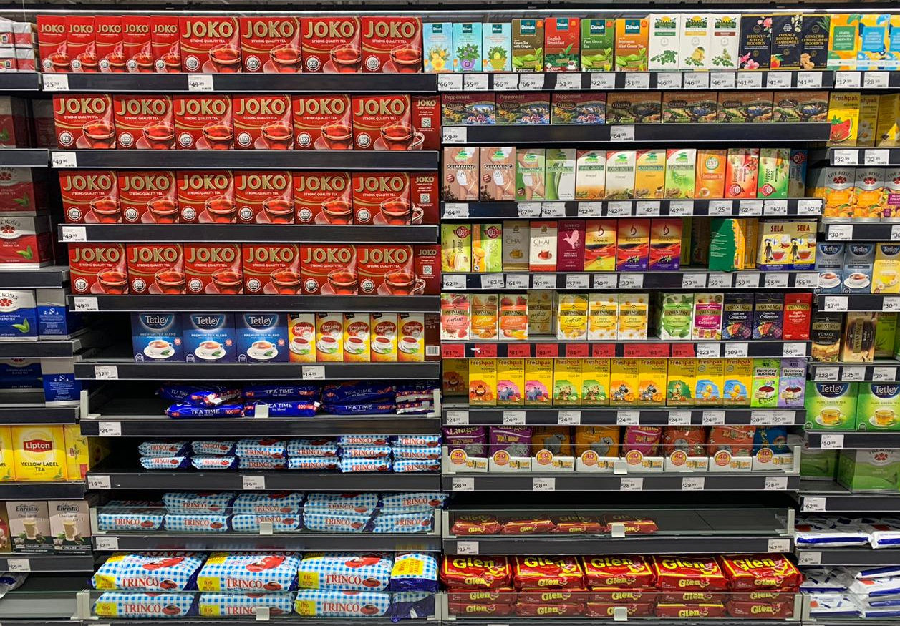
Pick n Pay
Ferndale,
Johannesburg
Source: John Jeffrey Morrison (2023)
Notes:
Present my preliminary findings for my thesis
Supervisor is Gillian

Slide 3
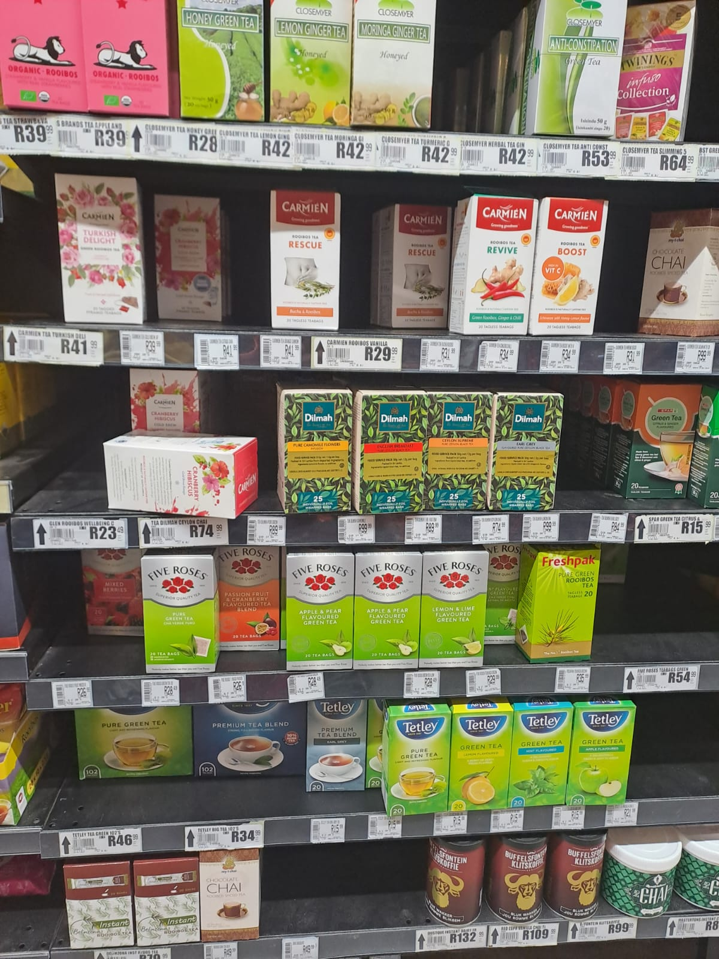
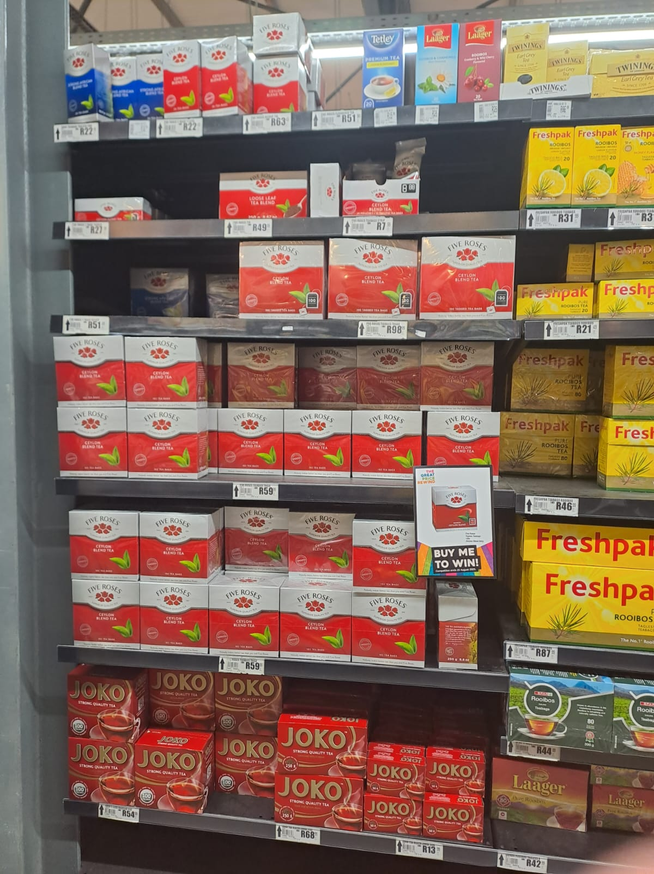
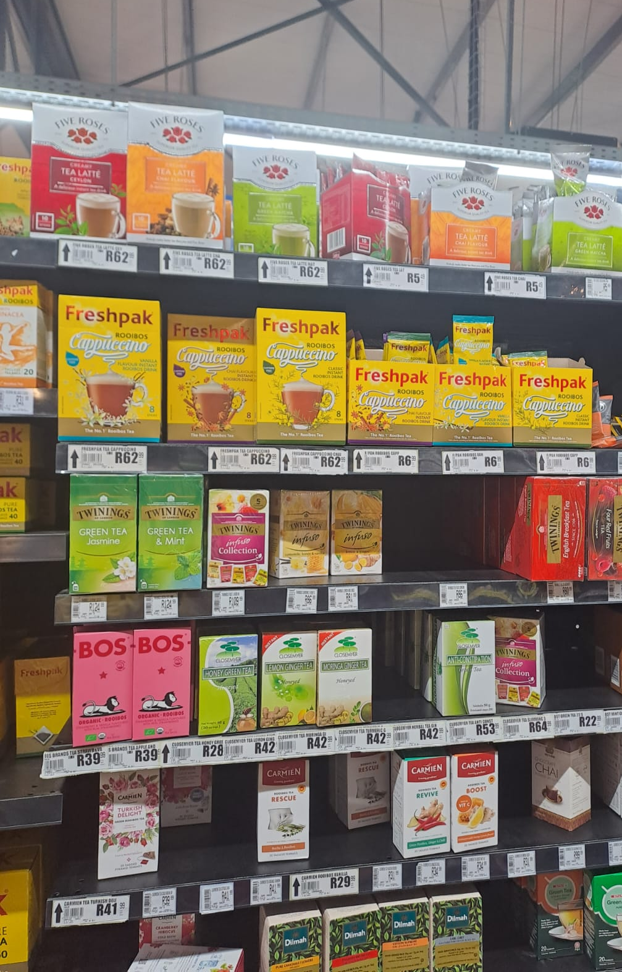
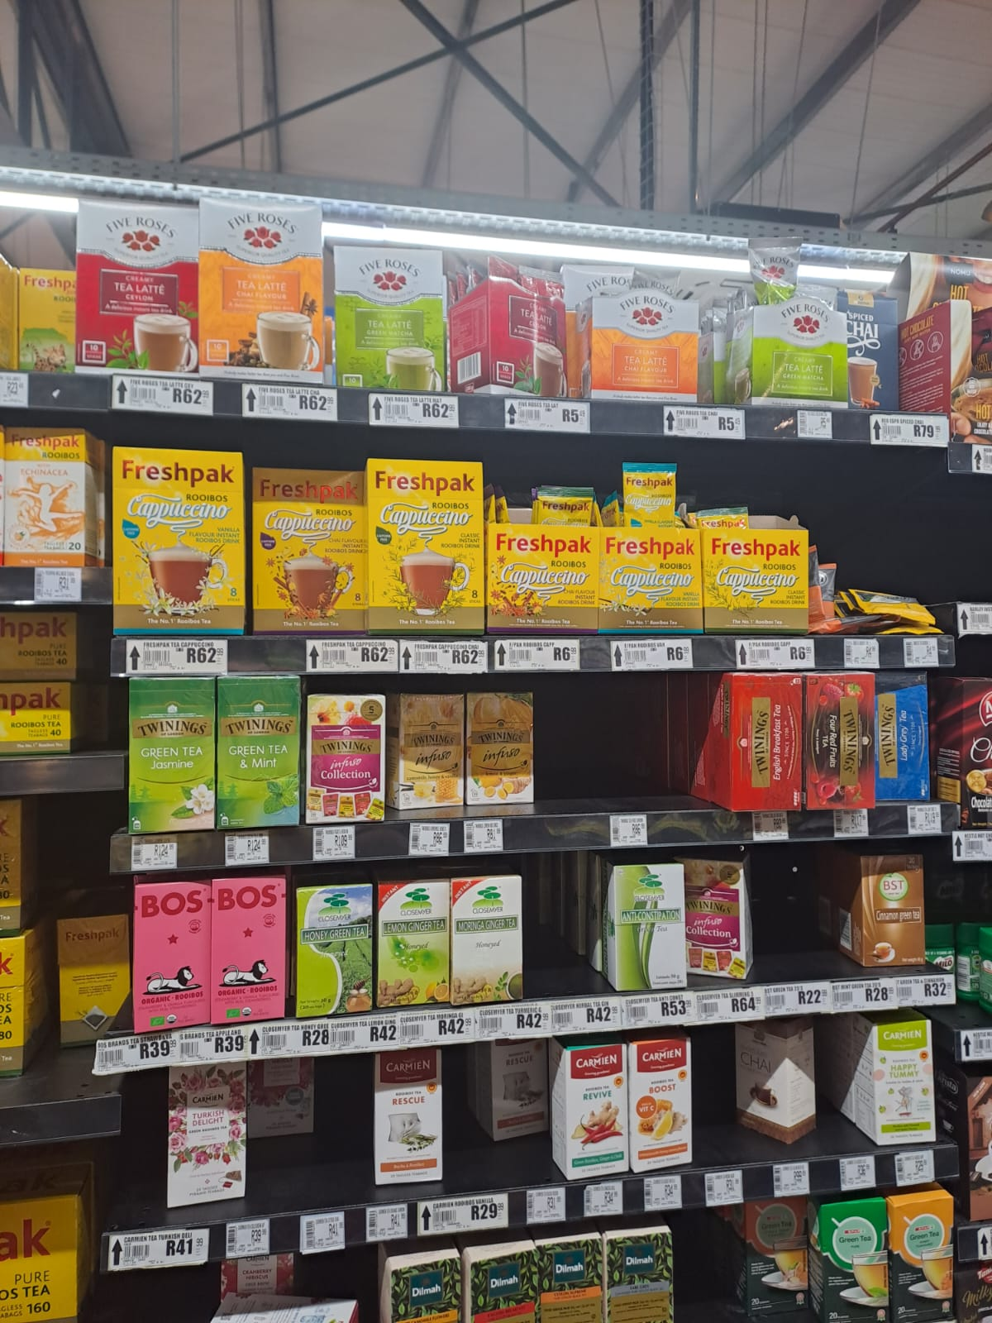
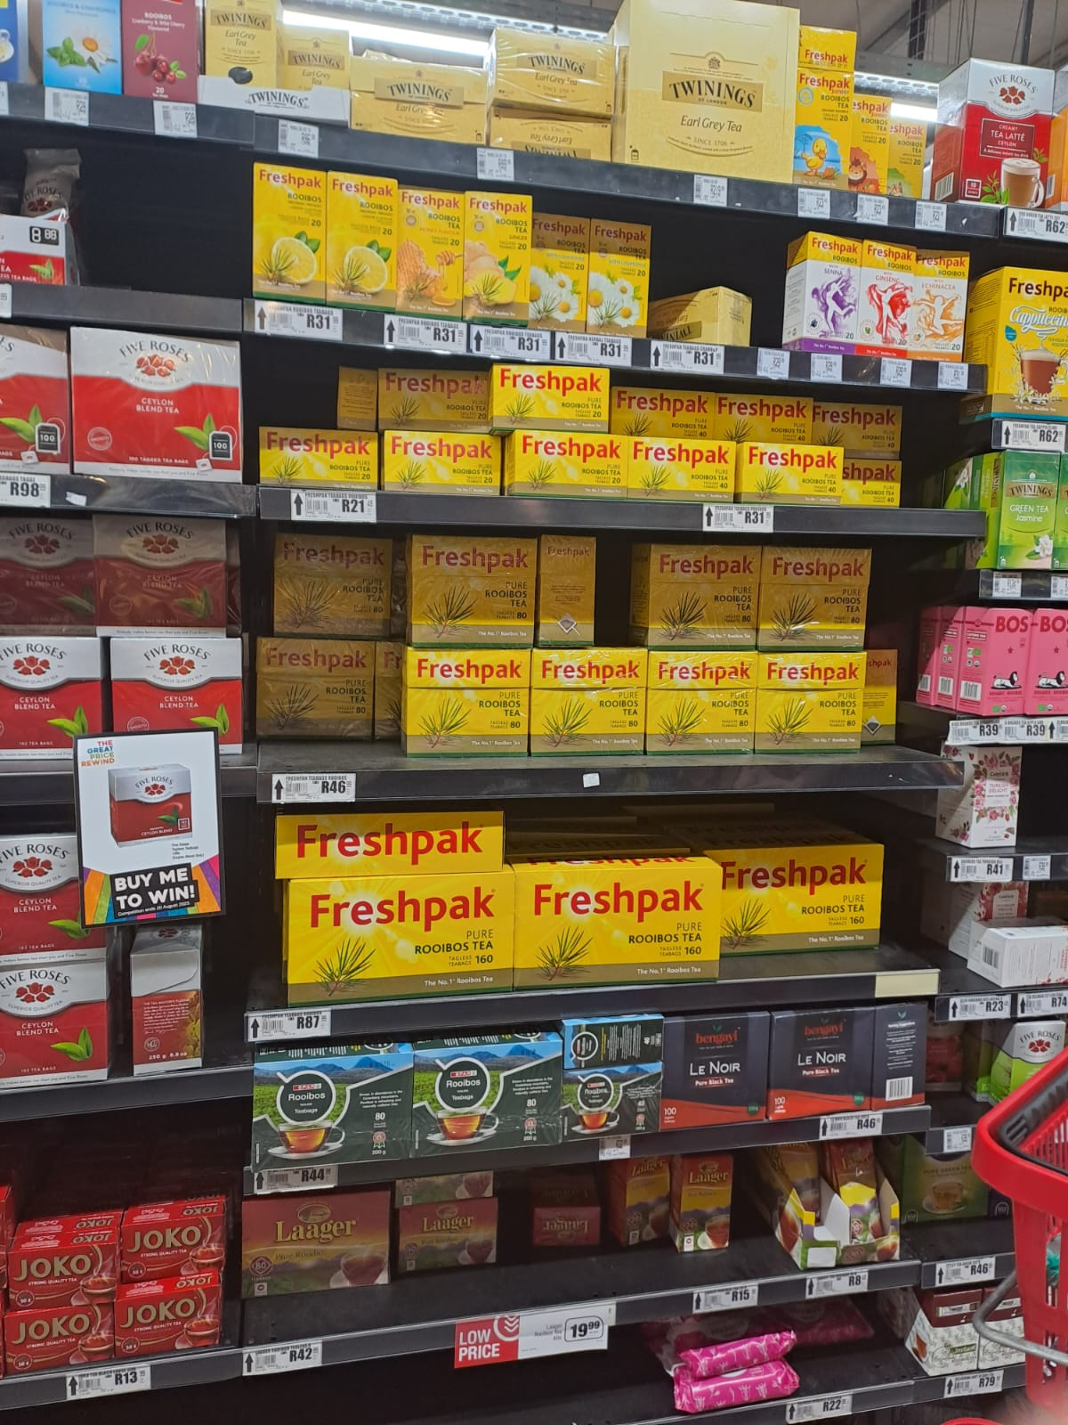
Pick n Pay
Sedgefield
Source: Rachel Putzier (2023)
Notes:
Present my preliminary findings for my thesis
Supervisor is Gillian

Slide 4
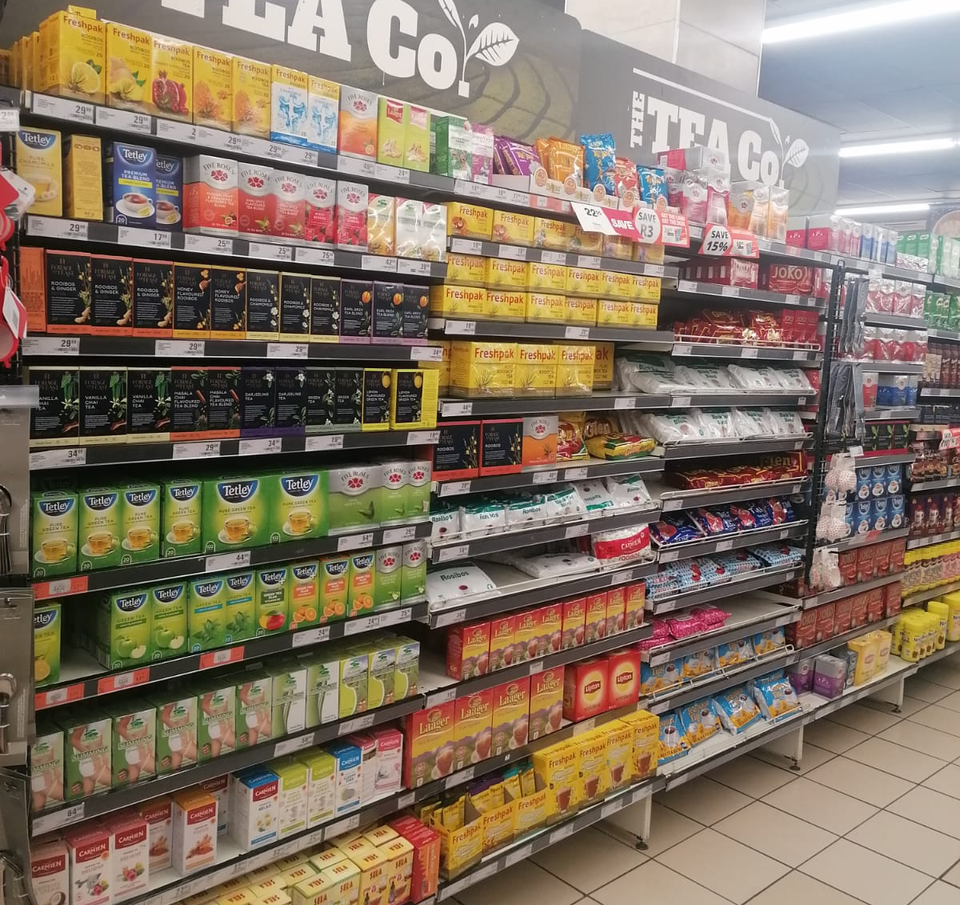
Checkers
Makhanda
Source: Huresha Padaycahee (2023)
Notes:
Present my preliminary findings for my thesis
Supervisor is Gillian

Slide 5
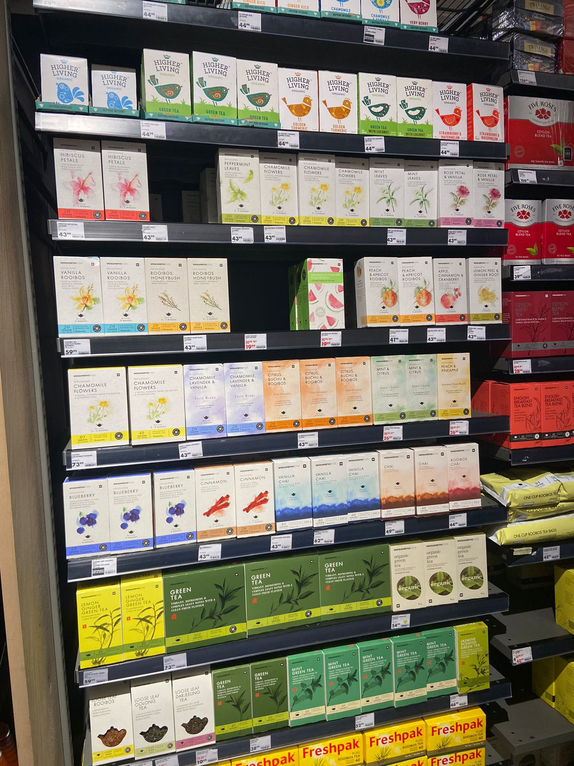
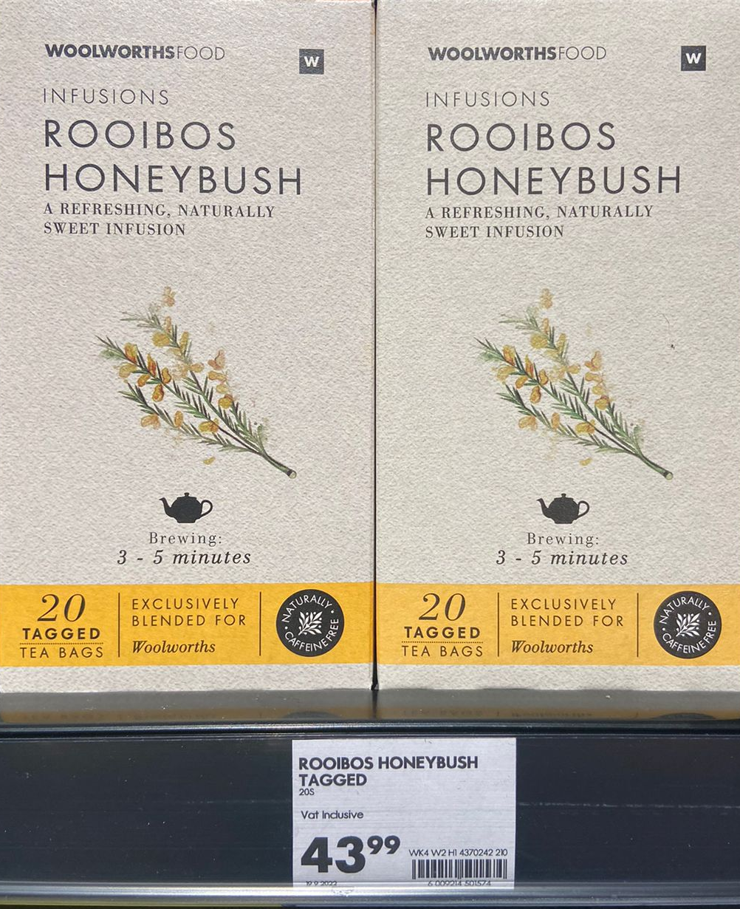
Woolworths
Cape Town
1
Source: Nicola Bowen (2023)
Notes:
Present my preliminary findings for my thesis
Supervisor is Gillian

Slide 6
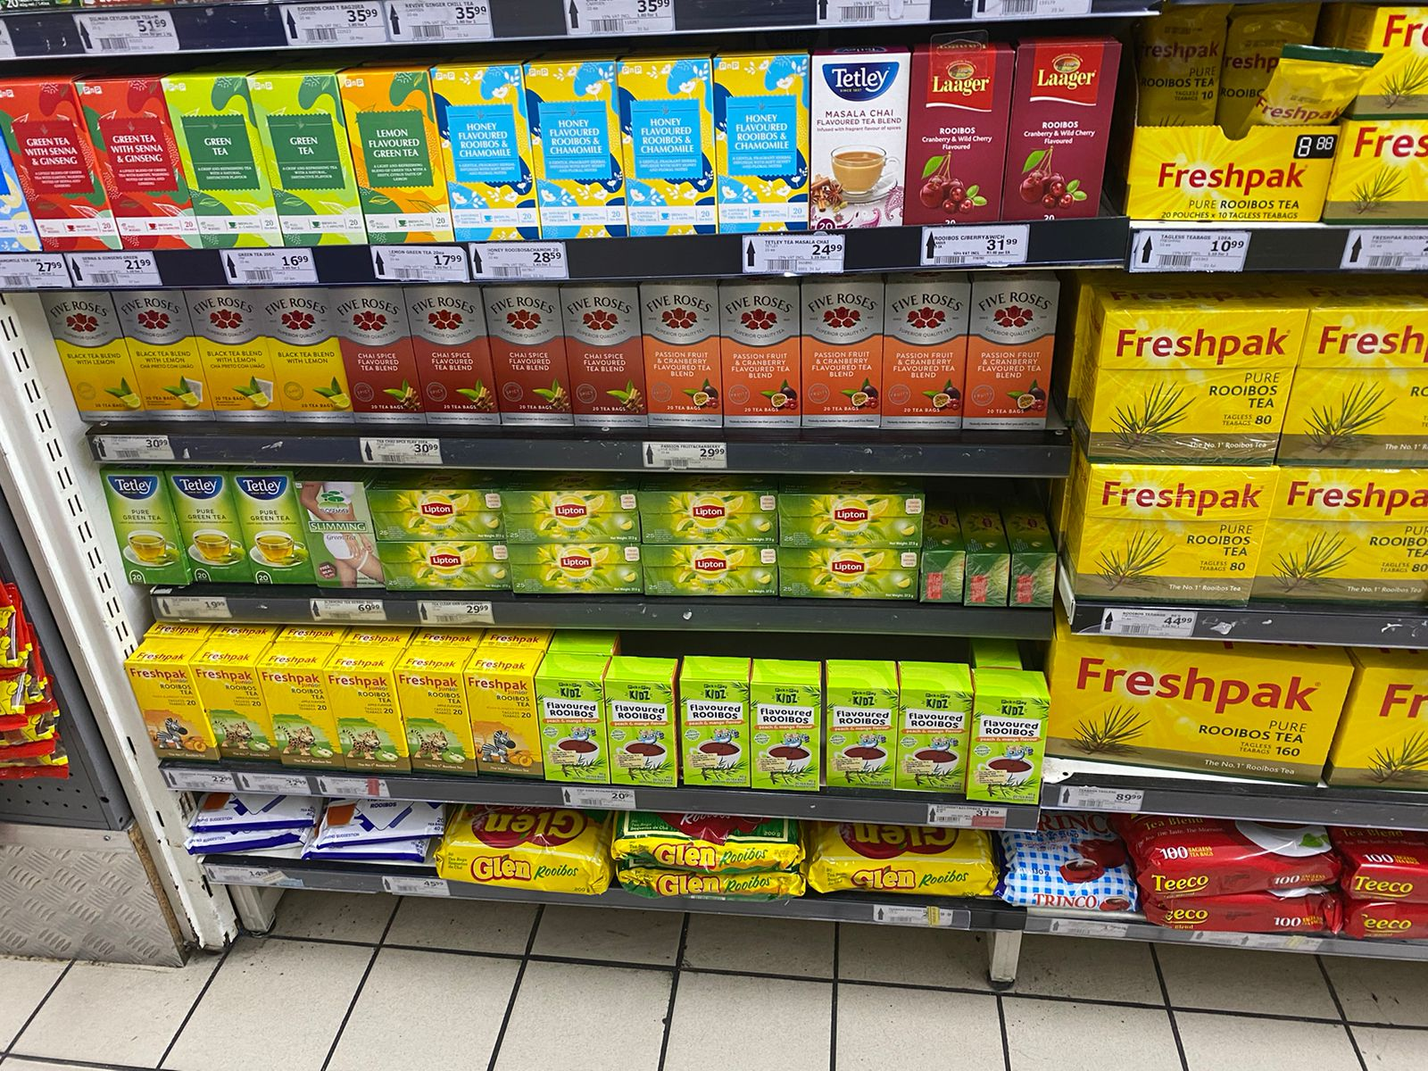
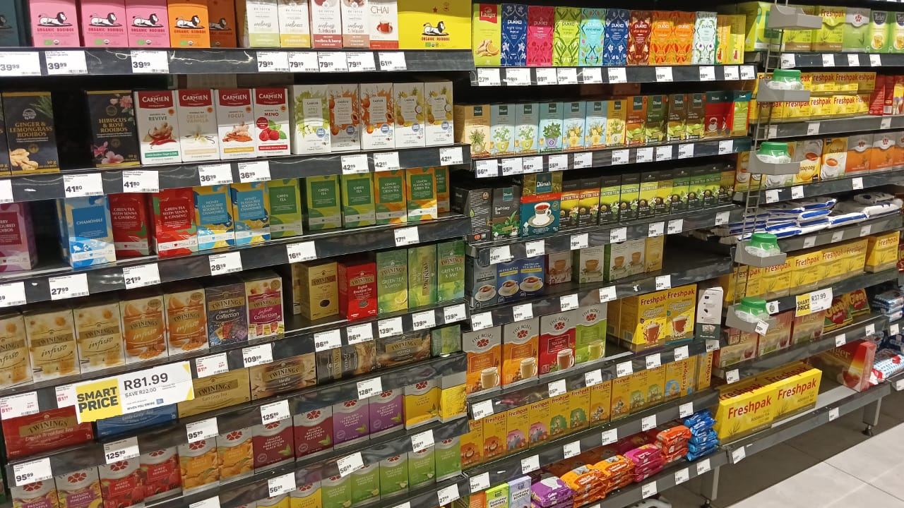
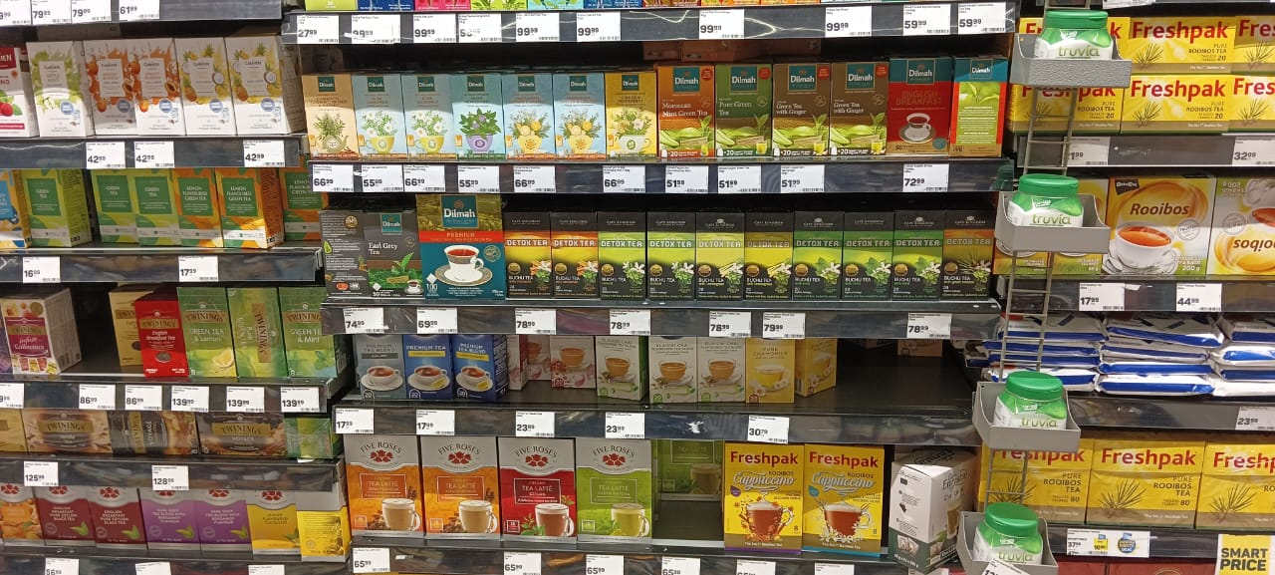
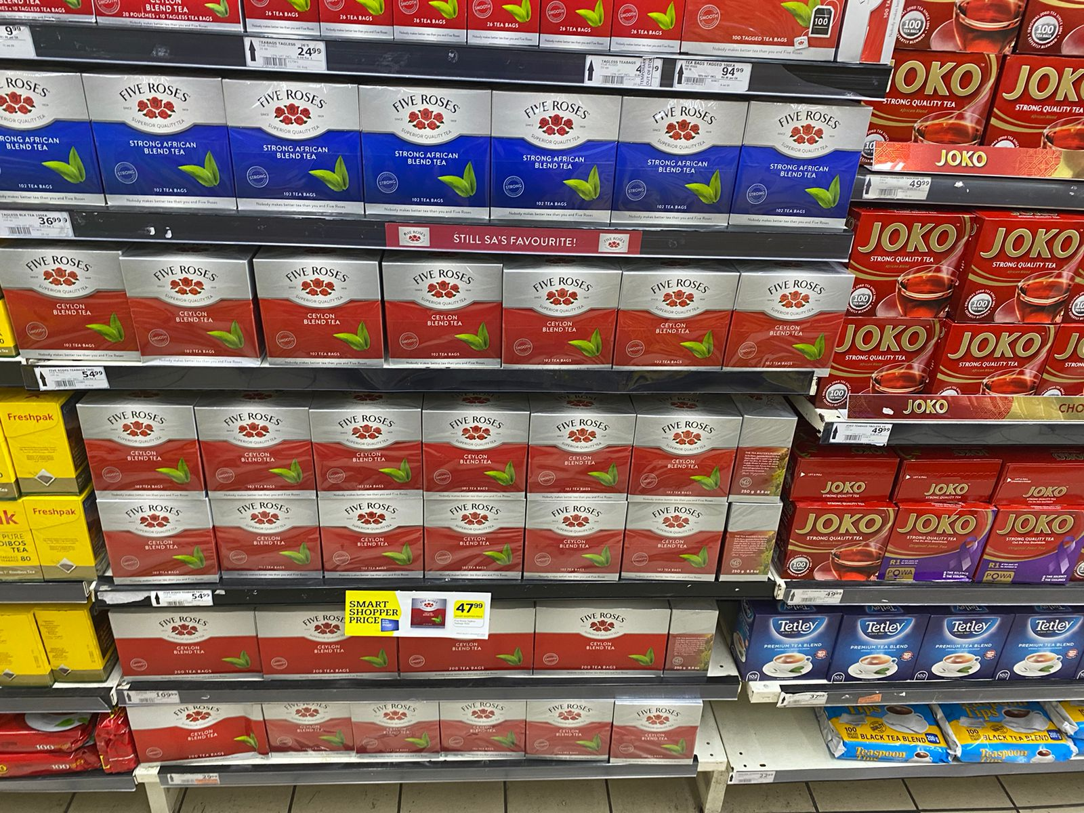
Pick n Pay
Bedfordview,
Johannesburg
2
Source: Kudakwashe Makhuza (2023)
Notes:
Present my preliminary findings for my thesis
Supervisor is Gillian

Slide 7
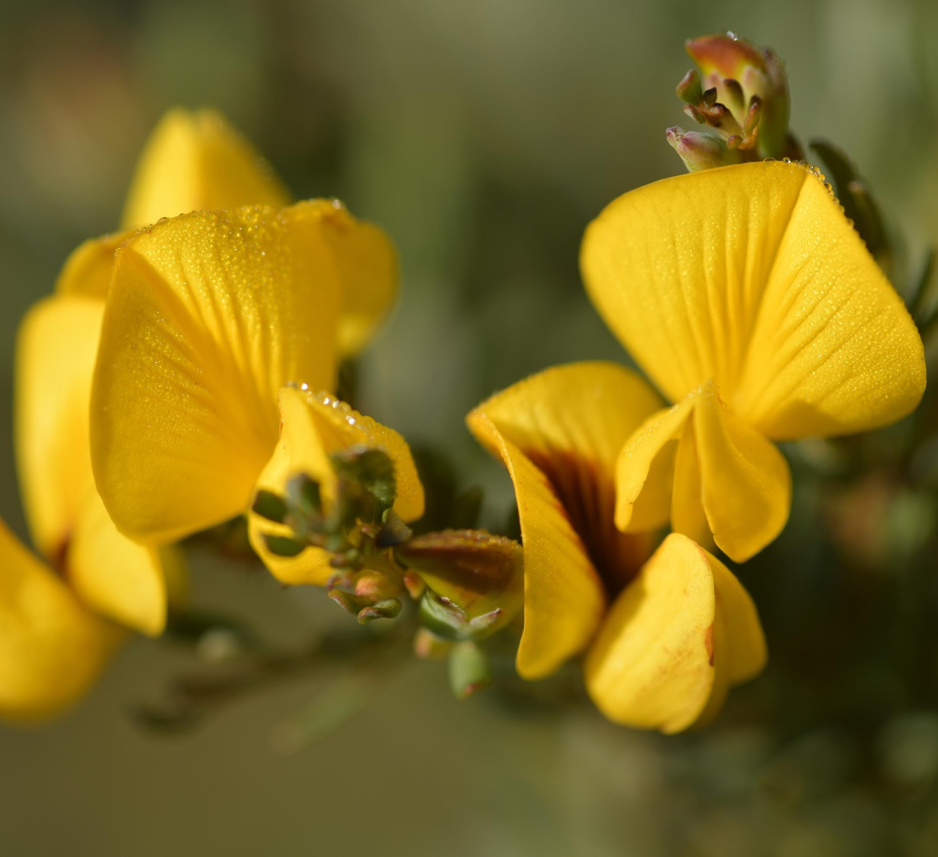
Aspects of the sustainability of the cultivated honeybush tea industry, South Africa
Preliminary Findings: Tafadzwa Makhuza
Funding: Rhodes Henderson Postgraduate Scholarship, Living Lands, T060 Prjoect
Department of Geography, Rhodes University
Supervisor: Gillian McGregor

Slide 8
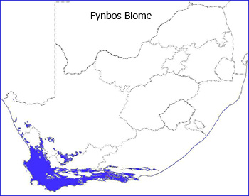
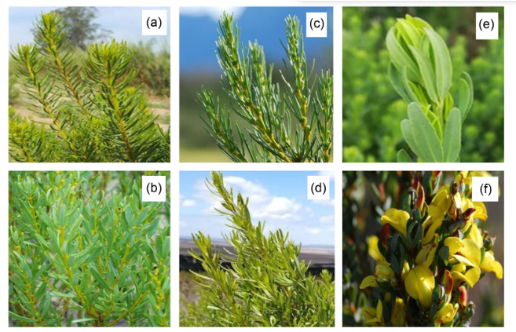
About Honeybush
Reseeder
Resprouter
a) C. genistoides (coastal tea)
b) C. longifolia (van Staden’s tea
c) C. maculata (rooibossie tee)
d) C. intermedia (mountain tea)
e) C. subternata (marsh tea)
f) C. sessiliflora (Heidelberg tea)
Source: a, b, d and e, Pippa A. Karsen; c and f, Agricultural Research Counci (2017)

Slide 9
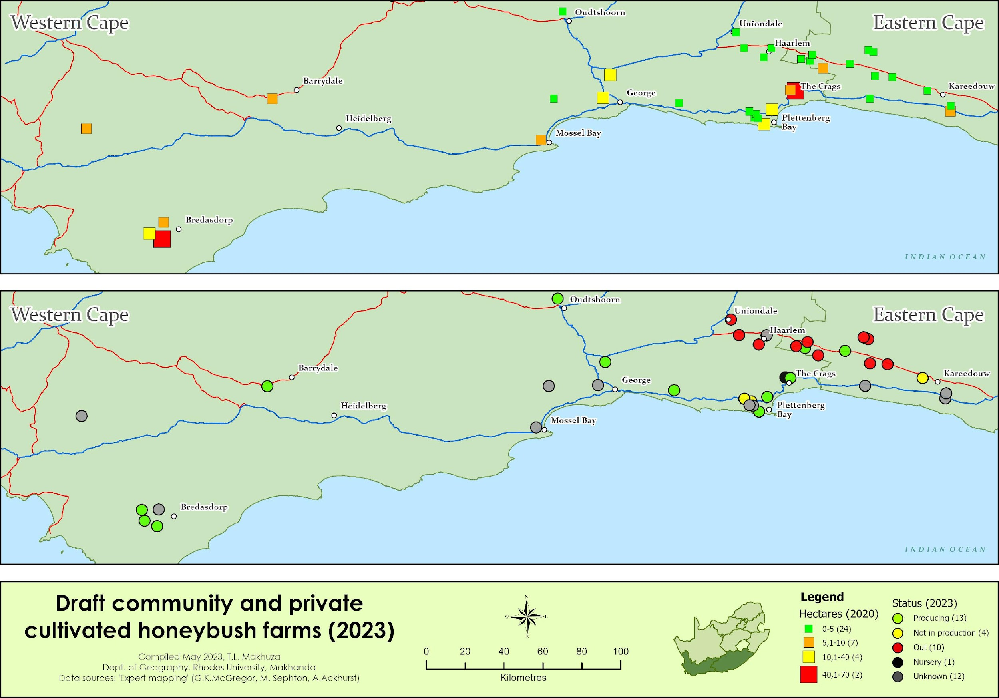
Problem
Statement
Only a few farmers have successfully established economically viable cultivation farms
2020
2023
Source of crop (wild vs. cultivated) in 2016, 2017 and 2019 (SAHTA, 2022; Pers. Comms., 2023)
Cultivated honeybush industry (2020 vs 2023) - DRAFT

Slide 10
Aim
Aim
to carry out an inventory and analysis of the various models of honeybush cultivation to bring out the successes and challenges of the various approaches.
The research will contribute to a better understanding of a way forward for the cultivated industry.
to carry out an inventory and analysis of the various models of honeybush cultivation to bring out the successes and challenges of the various approaches.
The research will contribute to a better understanding of a way forward for the cultivated industry.

Slide 11
Aim
Objective 1
Update the inventory of the cultivated industry
Aim
Objective 2
to carry out an inventory and analysis of the various models of honeybush cultivation to bring out the successes and challenges of the various approaches.
The research will contribute to a better understanding of a way forward for the cultivated industry.
Investigate the environmental, economic, and social practices in successful cultivation enterprises
to carry out an inventory and analysis of the various models of honeybush cultivation to bring out the successes and challenges of the various approaches.
The research will contribute to a better understanding of a way forward for the cultivated industry.
Objective 3
Investigate the challenges experienced by exiting as well as community enterprises
Objective 4
Develop a sustainable resource use framework considering environmental, economic, and social aspects which might be useful for future honeybush cultivation enterprises.

Slide 12
Conceptual framework
Sustainability
Environmental sustainability
SUSTAINABILITY
Economic
sustainability
Social sustainability

Slide 13
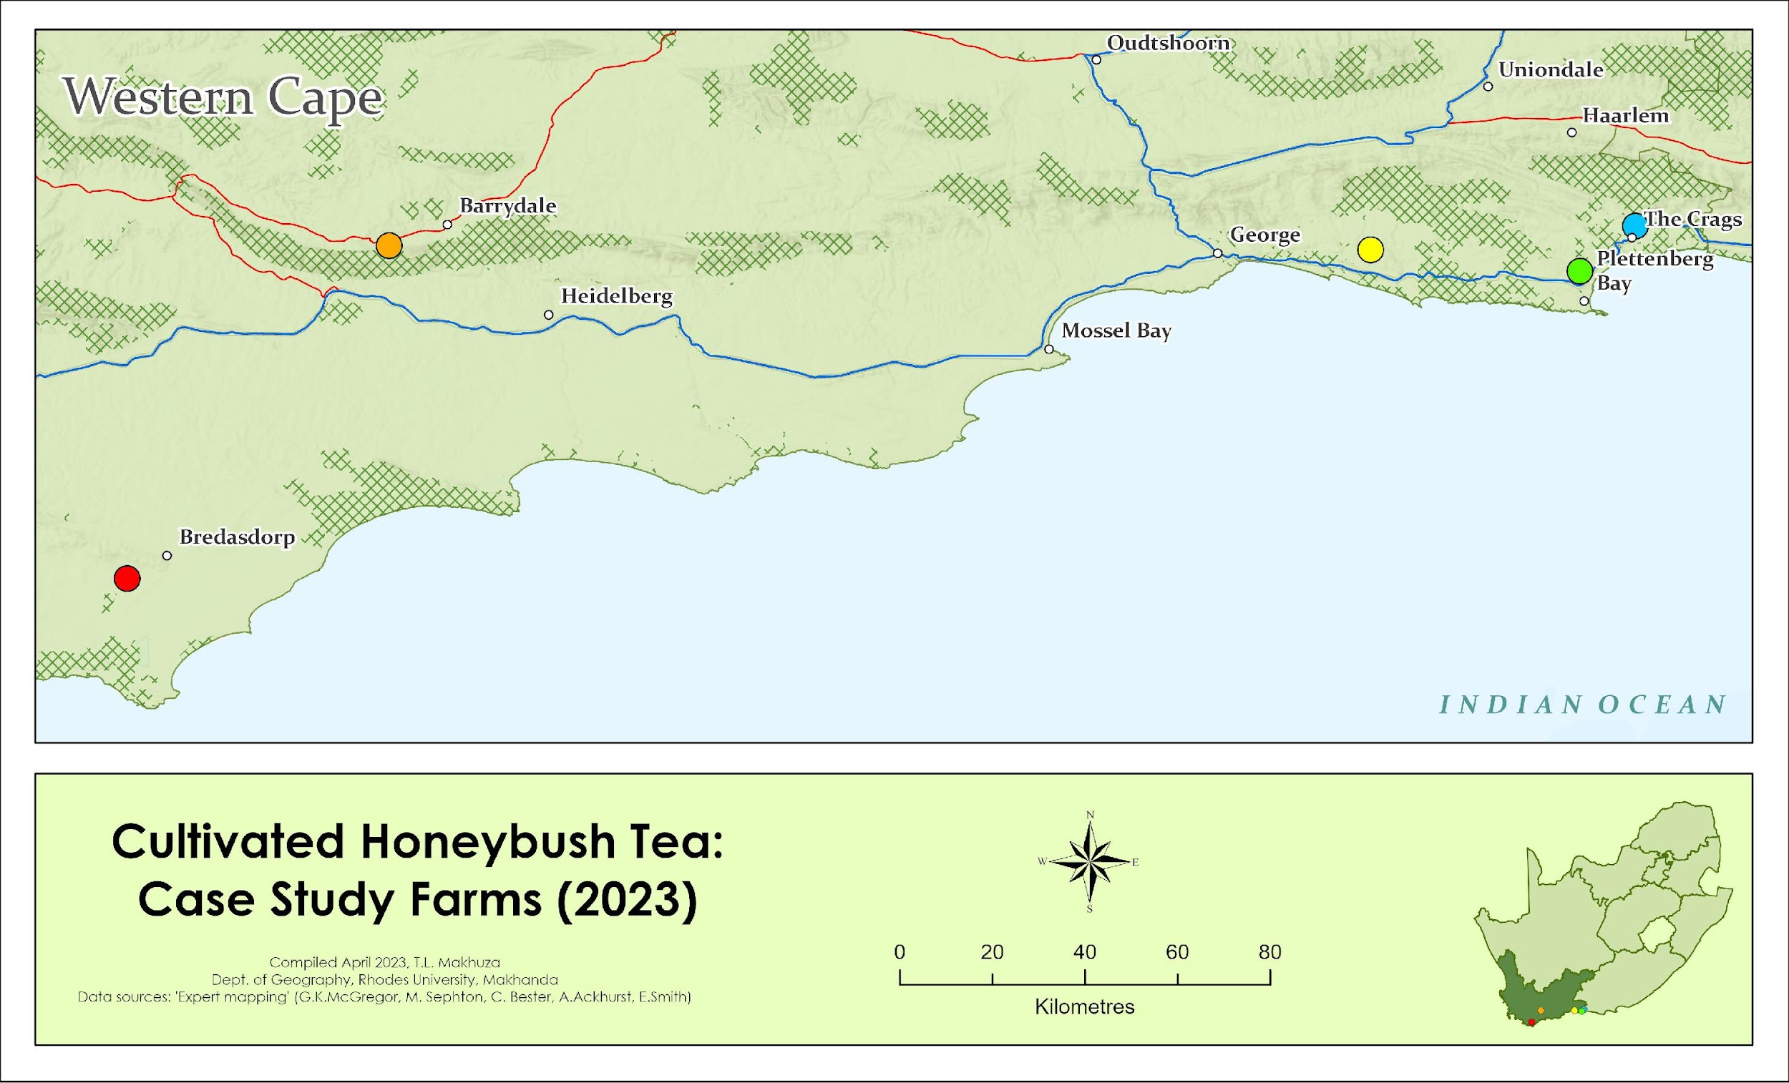
Study Area
Size: 5 ha
Species: C. subternata
Size: 67.2 ha
Species: C. longifolia
Size: 8 ha
Species: C. intermedia
Size: 60 ha
Species: C. genistoides
Size: 32 ha
Species: C. subternata
Reseeder
Resprouter
Study area of the five successful commercial farms which each have one of the models of interest

Slide 14
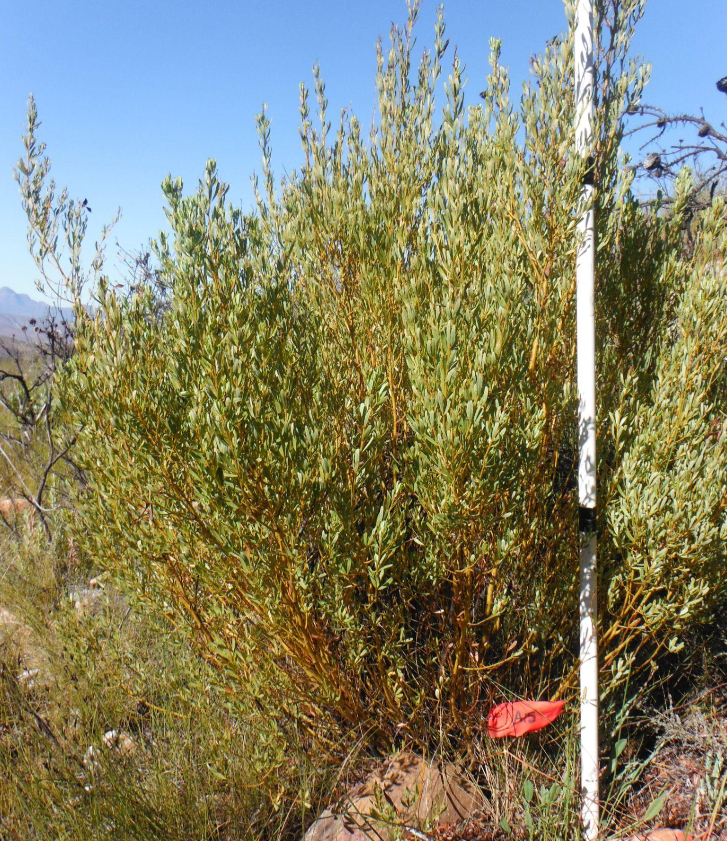
Farming Honeybush
Resprouter
(C. intermedia)
Reseeder
(C. subternata)
Rainfed
Rainfed/
Irrigation
Cropped after 2 or 3 years
Cropped annually
Low/ moderate density cultivation
Conventional/ intensive cultivation
Source: Gillian McGregor (2023)

Slide 15
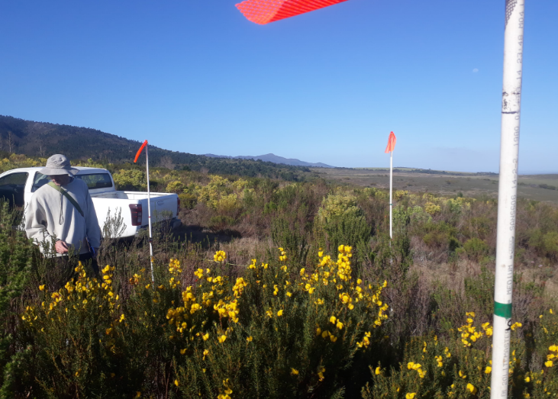
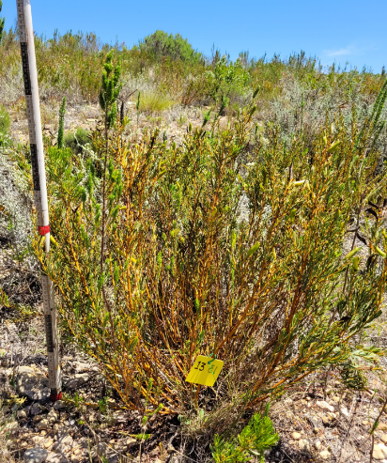
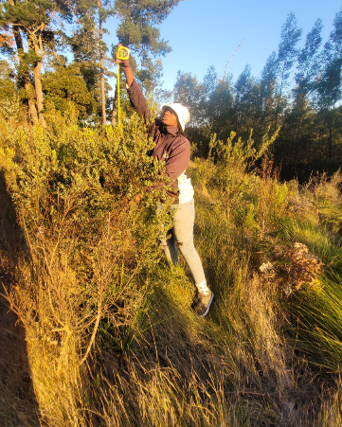
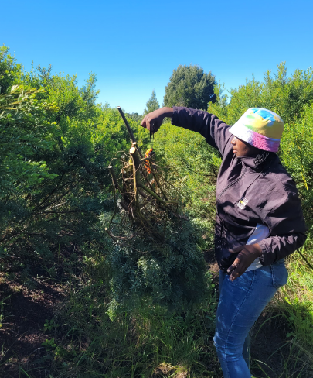
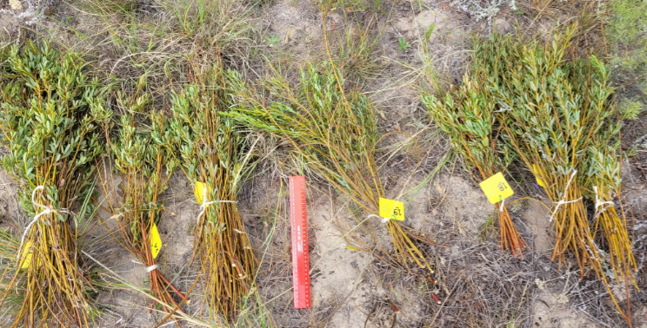
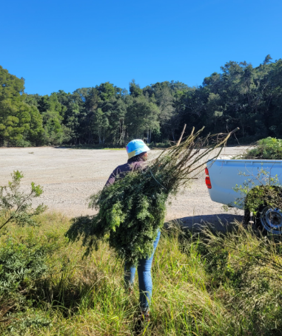
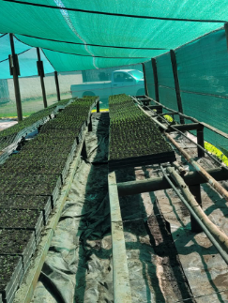
Source:Tafadzwa Makhuza (2022 - 2023)

Slide 16
Expected Outcomes
Conceptual framework
Enterprise (Type & Scale)
Successful Enterprises (2 reseeders & 2 resprouters) |  |  |  |  |  | Exiting Enterprises | Community Projects
Sustainability Pillar |  |  |  |  |  | Experience & Challenges | History & Current state
Economics |  | Environmental |  | Social
Challenges | Successes | Challenges | Successes | Challenges | Successes
Understanding Value Chain of Enterprise
Notes:
GENERAL
Competition: with species that are more desired (maculata and longifolia were the best in terms of biomass).
Market: there were times where farmer couldn’t sell tea anywhere/ anymore. If there was a contract and guarantee that the tea would consistently sell, it would make it better for most.
Sitting with tea and cannot sell it
School fees: No experience with the plant. For most cases, it was trial and error. Did not get any return. No worker (lots to do by themselves)
Organic certification is expensive for small scale farmers
Price: that was offered for the raw material made it no longer financially viable
PHYSICAL
Water: during dry spells, it would negatively impact the plants (especially Subternata, which needs a lot of water). Wants to put more plants in but cannot afford to water it.
Area: Some farmers did not have enough space to plant enough plants to make it economically viable (ideally, they would have stayed if they had enough space to make a rotational system where plants are different ages).
Cannot plant it less than a metre a part for subternata (because they get too big) – the lack of physical space.
Weather: One farmer was impacted by wind (where it tilts the plant, and the roots are exposed).
SPECIES
Pests: nematodes, ants, thrips (for subternata)
Die off: it was said approximately 20% mortality (which made it expensive if people were buying seedlings). In the one case with the subternata plots, they haven’t been harvested in 2 years but they are already dying.
Didn’t know there were different species.
Yields: The places where plants were taken would take a specific amount of yield but yields weren’t looking too good (harvest more than they had)
If you plant things in a row, that’s when problems will grow (need companion plants) – nature shows.

Slide 17
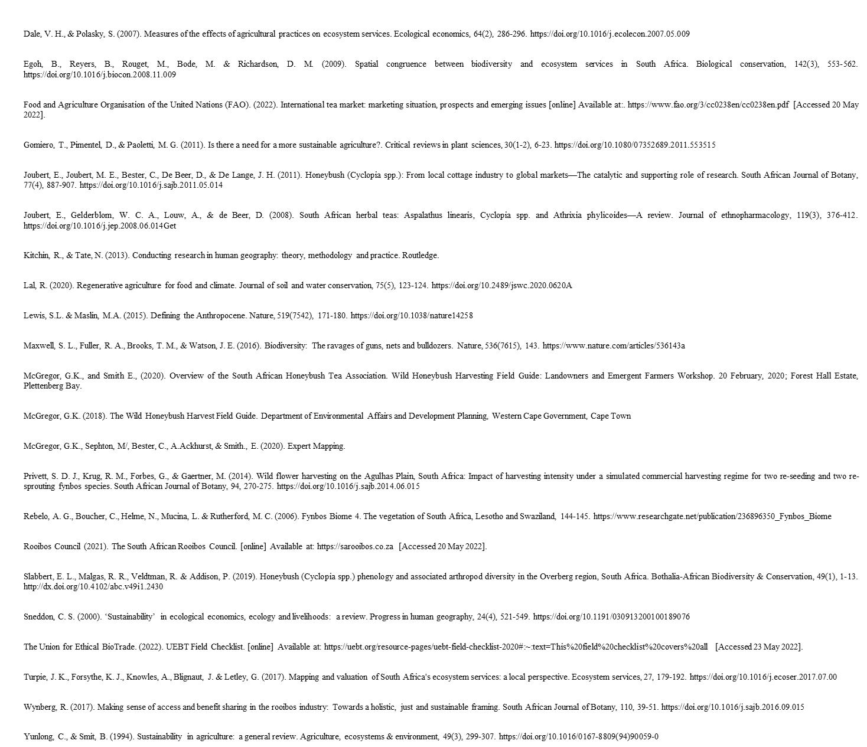
Thanks!
References
Thank you to everyone who has contributed to my findings thus far – from the 5 farms where I conducted my case studies, the stakeholders I have interviewed (from my proposal to my farm interviews), Living Lands for their generous help, Gillian McGregor (my supervisor).

